Slide 1
11 - Neural Networks
Machine Learning

Slide 2
Course Overview:
1.1 - Python Review
1.2 - Numpy
1.3 - Pandas
1.4 - Seaborn
2.1 - ML Intro
2.2 - Linear Regression
2.3 - Logistic Regression
2.4 -Naïve Bayes Classifier
2.5 - KNN
2.6 - Decision Trees
3.1 – Ensembling Learning
3.2 - Neural Networks
4.* - Natural Language Processing (NLP)
5.* Competition Tips & Final Thoughts

Slide 3
Origins of Neural Networks
01
What are neural networks?
02
Gradient Descent
Activation Functions
TABLE OF CONTENTS
04
03
Backpropagation
05
Implementation
06

Slide 4
01
Origins of Neural Networks

Slide 5
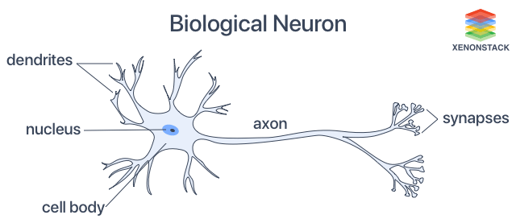
Biological Neurons
Based on a biological neuron
Dendrites accept input signals
Does something in the nucleus
Axon is the output

Slide 6
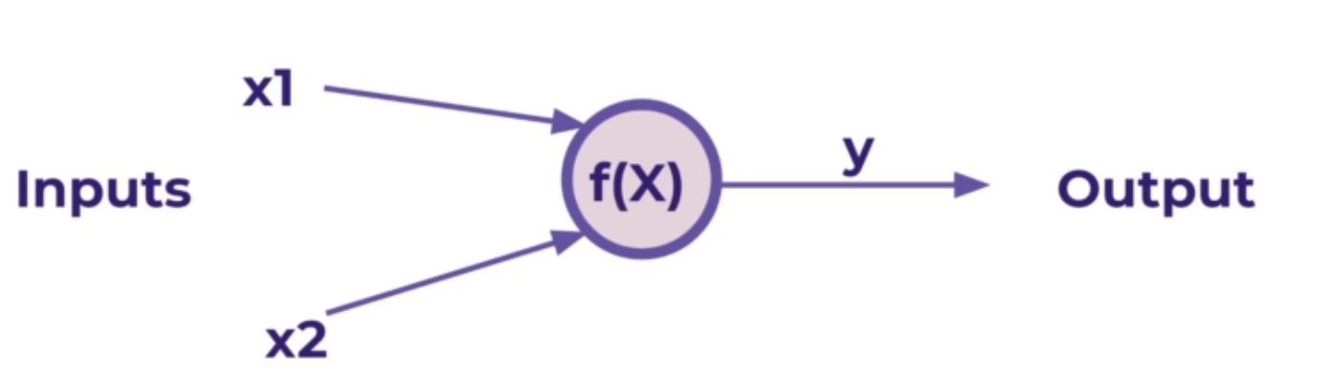
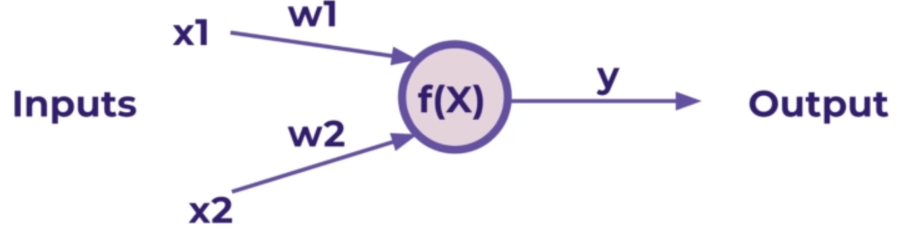
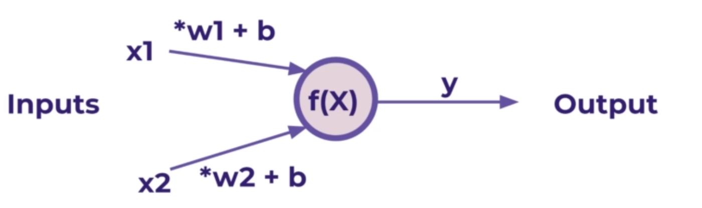
Perceptron Model
If f(x) is just a sum, then y = x1 + x2
How do we make it learn?
Add weights
Can be positive or negative
Now, y = x1w1 + x2w2
But what if x is a zero?
Add biases
Now, y = (x1w1 + b) + (x2w2 + b)

Slide 7
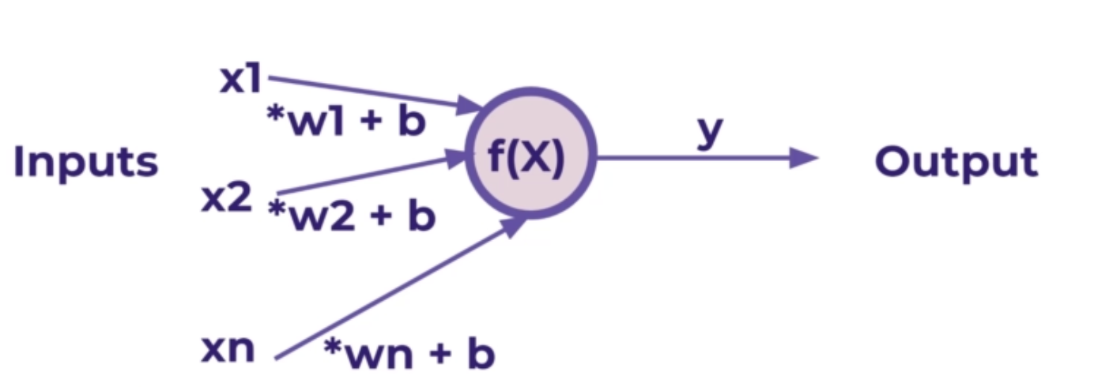
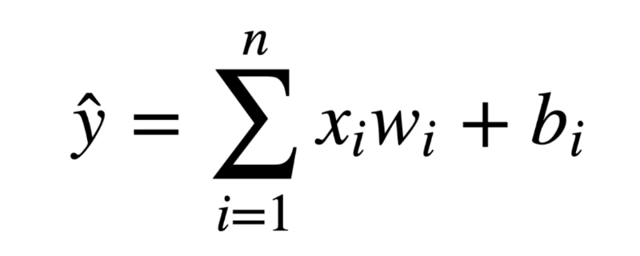
Generalizations
We can generalize the perceptron model for n number of inputs
Mathematical generalization
Later, we can see how to expand this model to have X be a tensor (an n-dimensional matrix)

Slide 8
02
What is a Neural Network?

Slide 9
What is a Neural Network?
A neural network is a multi-layer perceptron model
The outputs of one perceptron are fed as the inputs to another perceptron
This allows the network to learn about the relationships between features

Slide 10

Parts of a Neural Network
Input Layer
Hidden Layers
Difficult to interpret due to distance away from known values
If there are 2 or more hidden layers, the model is called a deep neural network
Output Layer
Can be more than one neuron

Slide 11
Classification
Our previous perceptron model was just a simple summation function f(x)
But in classification, it would be more useful to have the outputs between 0 and 1
We will see how to use activation functions to set boundaries for the output values of neurons

Slide 12
03
Activation Functions

Slide 13
What are activation functions?
Recall that inputs x have a weight w and a bias b
That can be written as x*w + b
We want to limit the output value of x*w + b
We can say z = x*w + b
And pass z through some activation function
Activation functions limit the output value of a given input
Z is a tensor input
Represents all of the input values in the neural network
Refer to activation functions as f(Z)

Slide 14
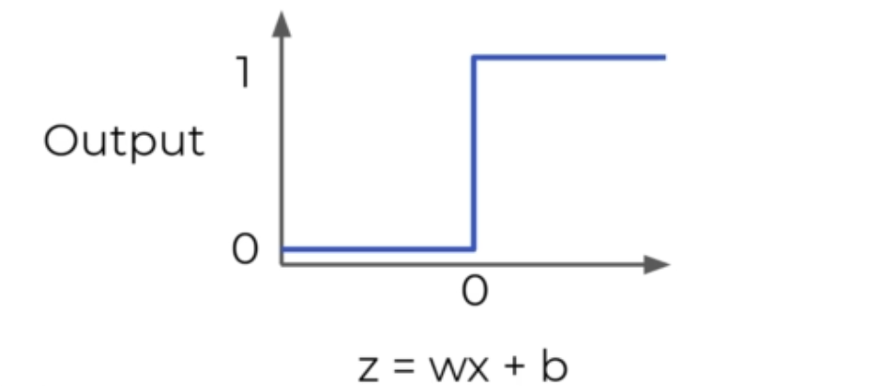
Step Function
Outputs a 0 or 1
Useful for classification
However, small changes aren’t reflected
Better to have a more dynamic function

Slide 15
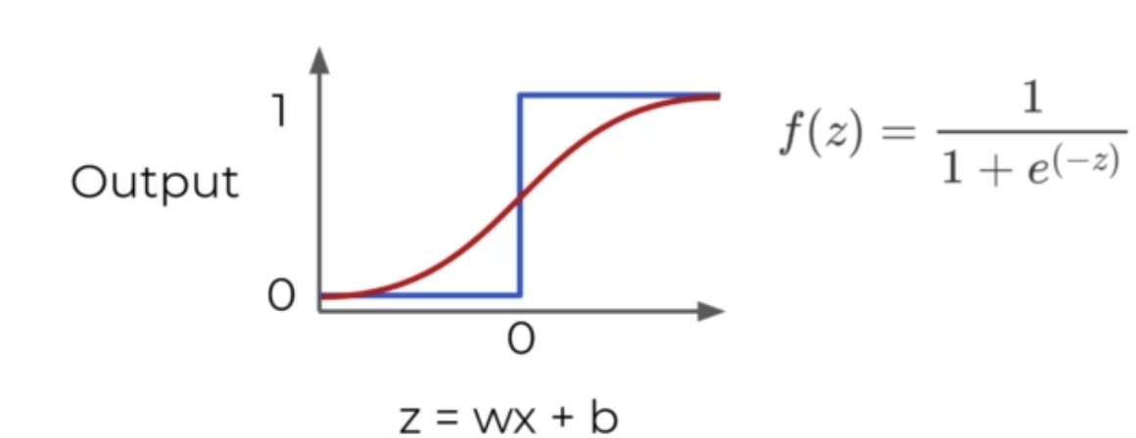
Sigmoid Function
Has the same lower and upper bound as step function
Z = w*x+b
More sensitive for small changes

Slide 16
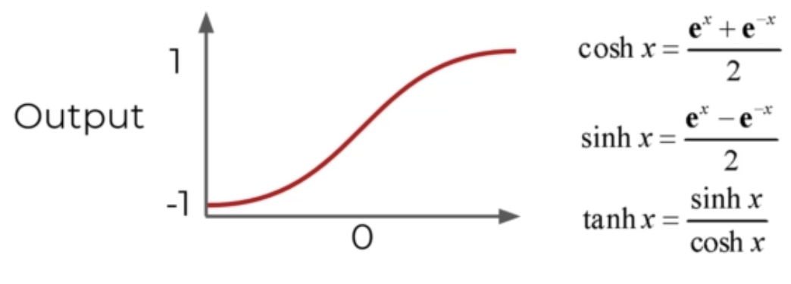
Hyperbolic Tangent - tanh(z)
Outputs between -1 and 1 instead of 0 to 1
Similar to sigmoid except for lower bound

Slide 17

ReLu Function
Stands for Rectified Linear Unit
If the output is less than 0, we treat it as 0
If the output is greater than 0, just output Z
ReLu has really good performance, especially when dealing with vanishing gradient

Slide 18
Other Activation Functions
For a full list of possible activation functions check out:
https://en.wikipedia.org/wiki/Activation_function

Slide 19
04
Gradient Descent

Slide 20
Loss Functions
Used to compare neural network outputs to the true value
Must be an average
We’ll use these variables
y to represent the true value
a to represent the neuron’s prediction
In terms of weights and biases:
Z = w*x + b
Pass Z into activation function σ(Z) = a

Slide 21
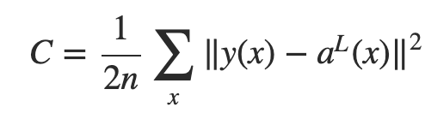
Quadratic Cost Function
We calculate the difference between real values y(x) against predicted values a(x)
L is the last layer
Squaring this is useful
Keeps everything positive
Punishes large errors

Slide 22
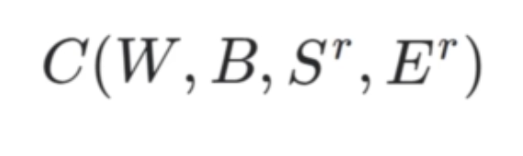
Inputs of a Loss Function
W are the weights
B are the biases
S^{r} is the input of a single training sample
E^{r} is the desired output of that training sample
W and B are encoded into a(x)

Slide 23
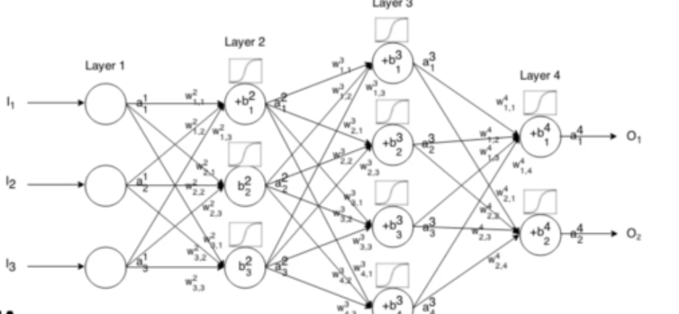
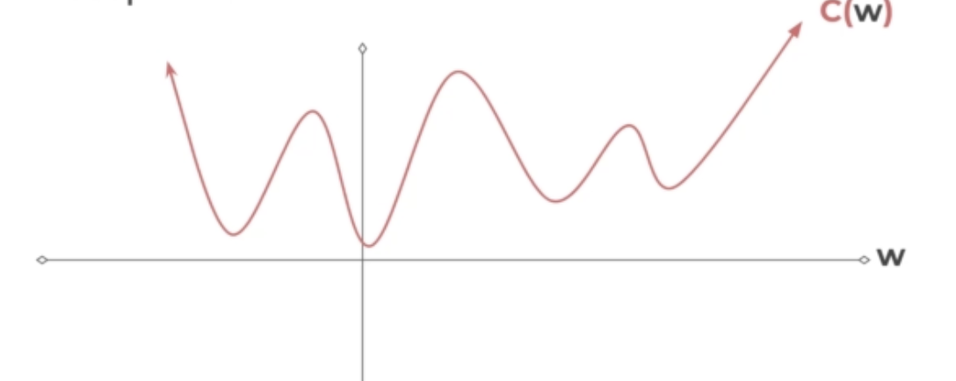
Minimizing Loss
Loss functions get really complex, really fast
How do we minimize the loss?
What value of w results in the minimum value of C(w)?
Gradient descent!

Slide 24
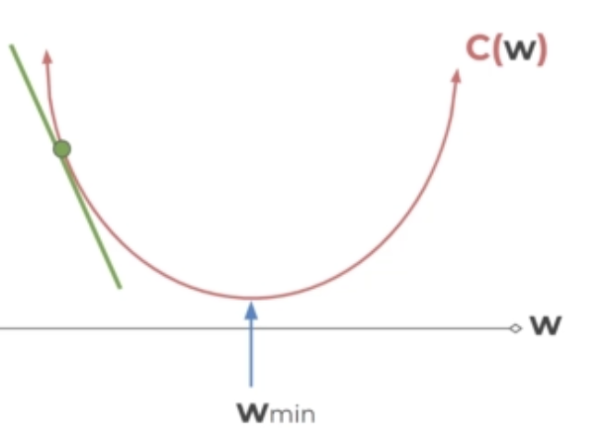
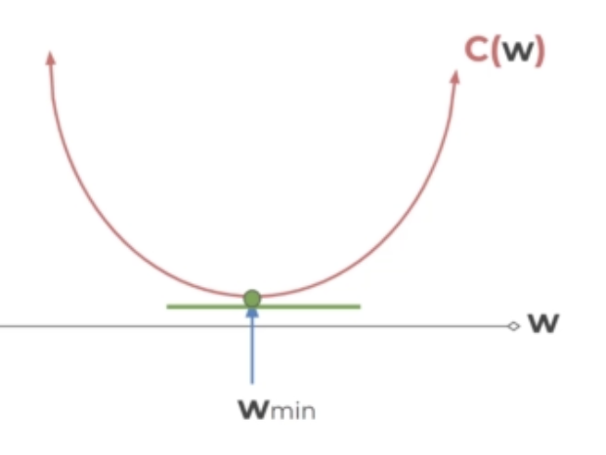
How to perform Gradient Descent
Calculate the slope at a point
Then move in the downward direction of the slope
Until it converges to 0
Indicates the minimum

Slide 25
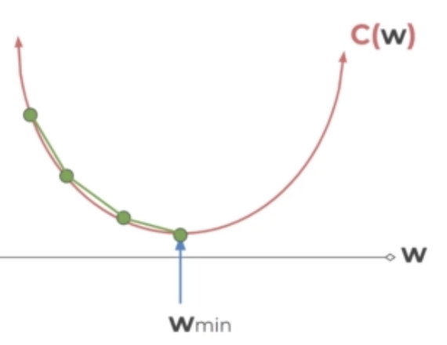
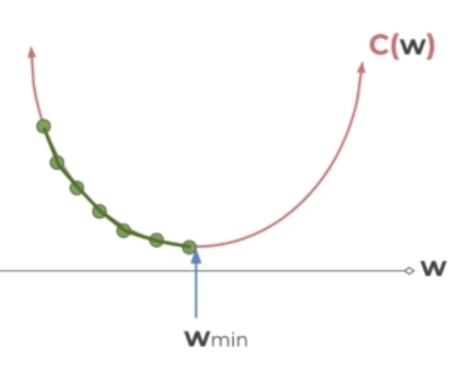
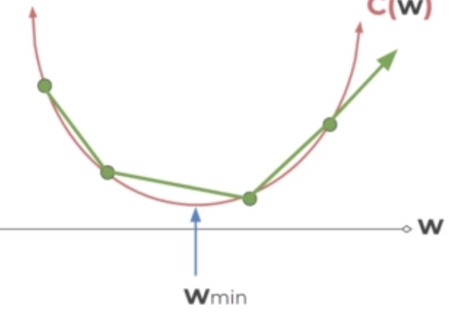
Learning Rate
Our steps
Smaller step sizes take longer
Larger steps are faster, but risk overshooting the minimum
Step size is known as the learning rate
We could start with larger steps, then go smaller as the slope gets closer to 0
Adaptive gradient descent

Slide 26
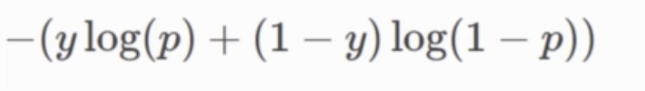
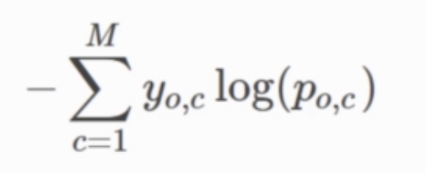
Cross Entropy
For classification problems, we often use the cross entropy loss function
Assumes that the model predicts a probability distribution p(y=i) for each class i=1,2,3,...C
For binary classification
For M number of classes > 2
Once we get our loss value, how do we update our weights and biases?
Backpropagation!

Slide 27
05
Backpropagation

Slide 28
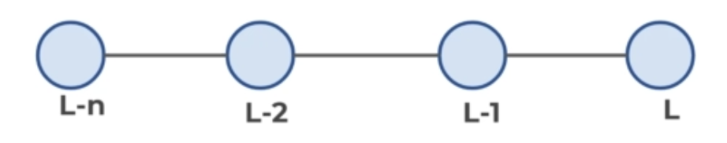
Defining Variables
L is the last layer, and the layers before are notated as L-1, L-2, etc.
Focusing on the last 2 layers, let’s define z = wx + b
Apply an activation function: a = σ(z)
This means we have z^{L} = w^{L}a^{L-1} + b^{L}
a^{L} = σ(z^{L})
C₀(...) = (a^{L} - y)²

Slide 29
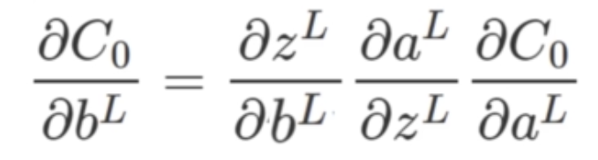
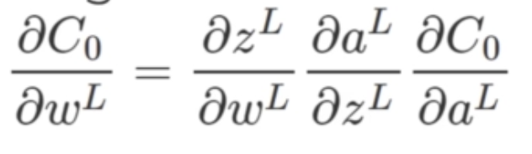
Partial Derivatives
We want to understand how sensitive the loss/cost function to changes in w
We can get these formulas for the weights and biases using the relationships we know with the chain rule
Main idea: we can use the derivative (gradient) to go back through the network and adjust the weights and biases to minimize error

Slide 30
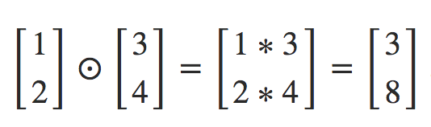
Hadamard Product
⊙ denotes a Hadamard product
Element-by-element multiplication
Matrices should be the exact same size
Matches up for weights and biases

Slide 31
Training Neural Networks
Step 1: Using input x to set the activation function a for the input layer
Z = wx + b
a = σ(z)
This a feeds into the next layer (and so on)
Step 2: For each layer, compute:
z^{L} = w^{L}a^{L-1} + b^{L}
a^{L} = σ(z^{L})
Step 3: Compute the error vector
δ^{L} = ∇_{a}C⊙σ′(z^{L})
∇_{a}C = (a^{L}-y)
Expressing the rate of change of C with respect to the output activations

Slide 32
Training Neural Networks (contd.)
Step 4: Backpropagate the error
This is the generalized error for any layer L
δ^{L} = (w^{L+1})^{T}δ^{L+1}⊙σ′(z^{L})
(w^{L+1})^{T} is the transpose of the weight matrix of L+1 layer
We can think of the transpose weight matrix as moving the error backward through the network, giving us some sort of measure of the error at the output of the Lth layer
Take the Hadamard product ⊙σ′(z^{L})
Moves the error backward through the activation function in layer L, giving us the error δ^{L} in the weighted input to layer L

Slide 33
06
Implementation

Slide 34
THANKS

